Slide 1

Tableau Data Exploration
CMP4007 Spring 2023
Getting Started

Slide 2
Agenda
What’s Tableau?
Download and connect
Data analysis with Tableau
Data Visualizations
Histograms
Bar chart
Marks card
Tooltips and annotations

Slide 3
What’s Tableau?
A powerful data visualization tool used in the Business Intelligence industry. It helps simplify raw data into an easily understandable format.
Through Tableau you can:
create powerful visualizations fast
make use of almost every kind of charts
make interactive dashboards

Slide 4
Download Tableau
Tableau public can be found through https://www.tableau.com/products/public/download
It is a free version of the Tableau Software that allows you to use most of the software functions. You can connect to CSV files, Excel spreadsheets, and text documents.
However, you will not be able to save your work locally on your computer. You will have to save and access it from Tableau Public.

Slide 5
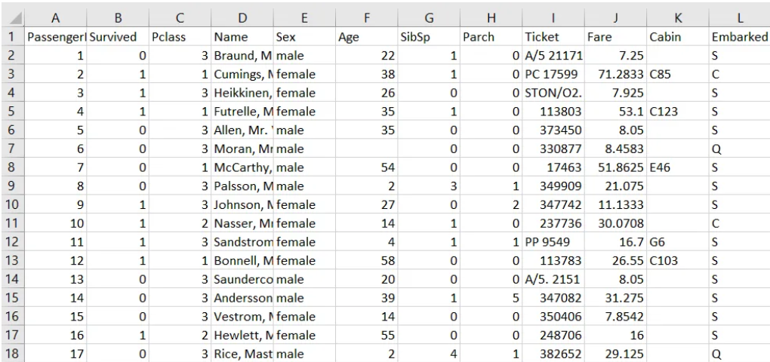
Case Study
The data set we will be using in this tutorial is Kaggle’s Titanic Dataset. Download the train.csv file, and save it as an Excel workbook.

Slide 6
Case Study (cont.)
Questions to answer through Tableau:
How many people survived the Titanic?
Which gender was more likely to survive the Titanic?
Did the class the passenger was in have any impact on their survival?
Were younger people more likely to survive the Titanic?
Were passengers who paid higher fares more likely to survive the Titanic?

Slide 7
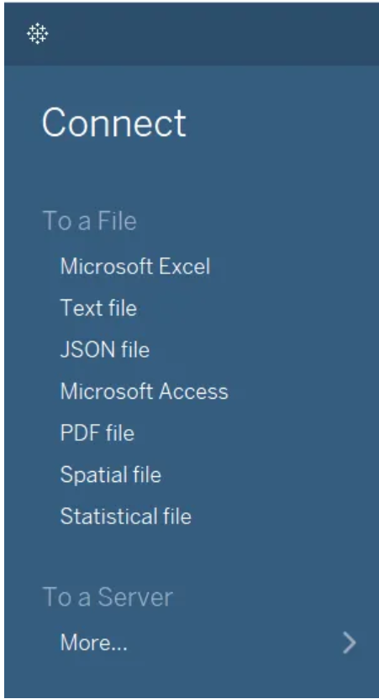
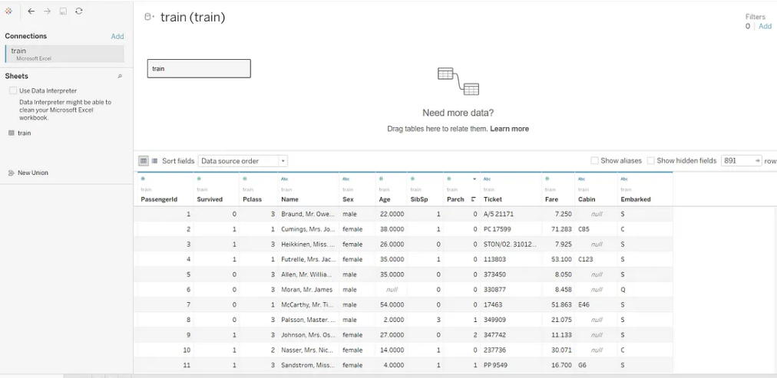
Connect Data Source
After installation, open Tableau to find this pane, select MS Excel and browse to the dataset you just downloaded. This window indicates successful load of data

Slide 8
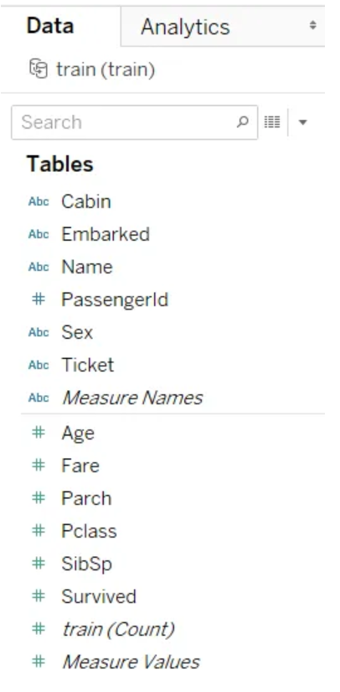
Data Analysis
After you load the data, you will see this pane on the left side of screen
Tableau classifies data according to:
Data type: string, DateTime, Decimal, etc
Measures vs Dimensions: quantitative vs qualitative
Data above the horizontal line are classified as dimensions, others are measures.
Tableau can misclassify some columns (as Pclass and survived), you need to drag and drop them to the correct group.

Slide 9
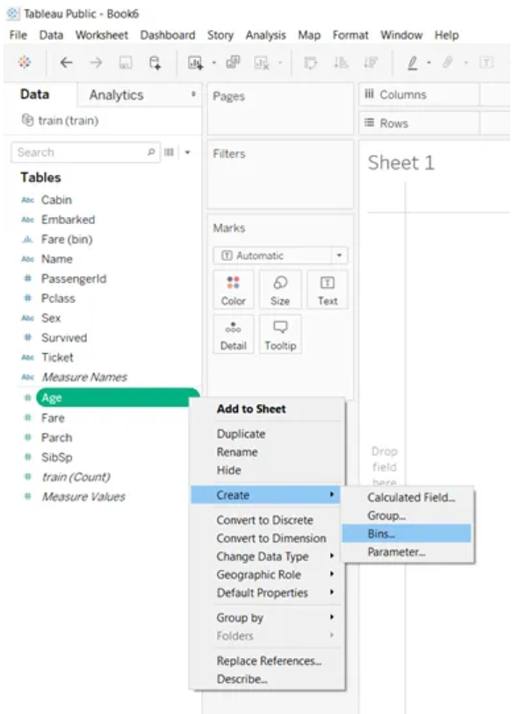
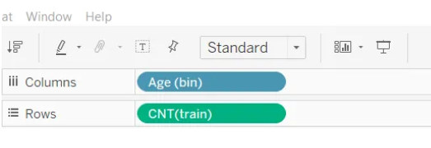
Data Visualization: histograms
Let’s draw a histogram to the ‘age’ column, you’ll be prompted to choose a bin size. Then to visualize, drag the age and CNT variables to the top pane

Slide 10
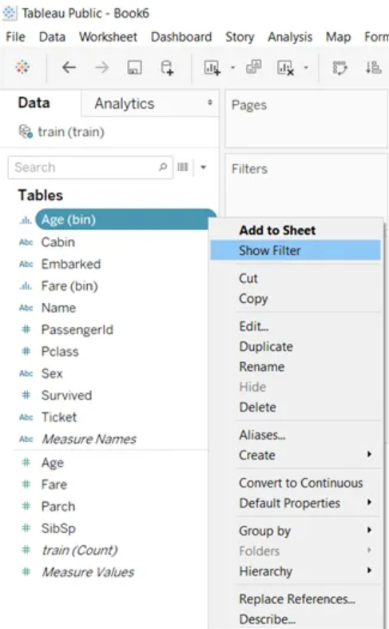
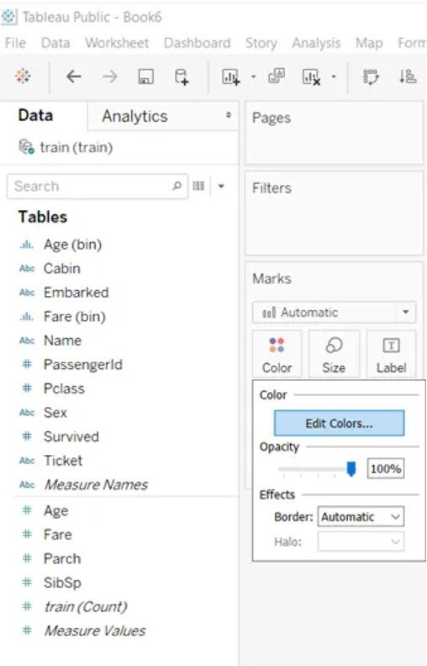
Data Visualization: histograms (cont.)
Null values can be present in your histogram, to fix this, click on show filter and uncheck ‘NULL’
You can change the color of histogram through the Marks card

Slide 11
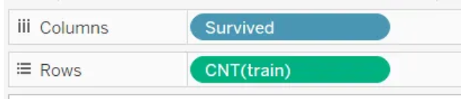
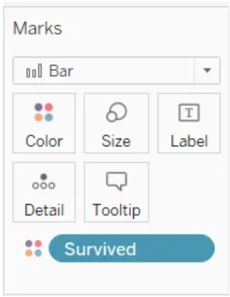
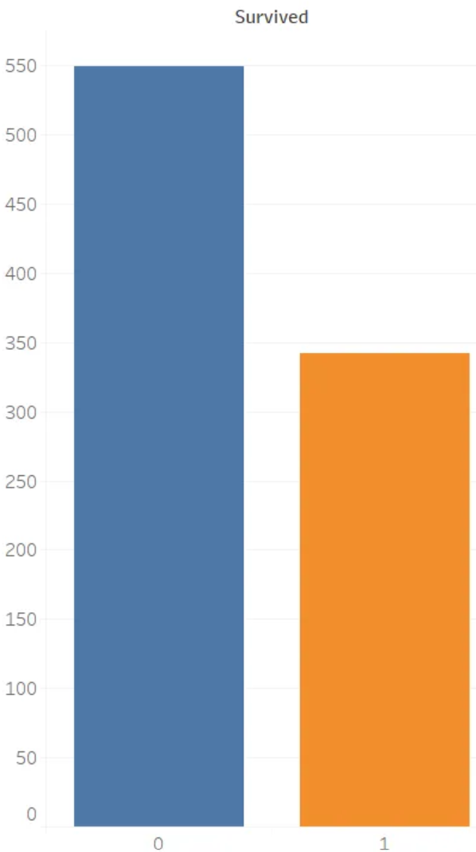
Data Visualization: Count Plots
For categorical data, we can use count plots in a similar way.
First, you have to remove ‘age’ column from the top pane, and Marks card, then put ‘survived’ instead.

Slide 12
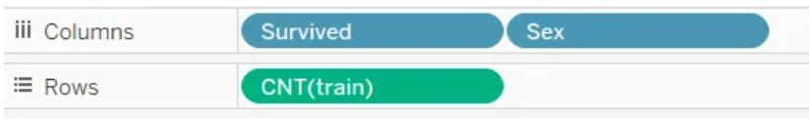
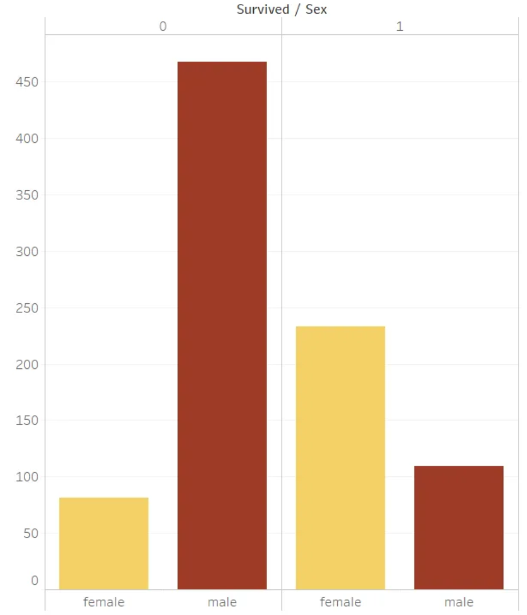
Data Visualization: Bar Chart
You can add 2 variables to your chart. Let’s compare between survival rates of males and females

Slide 13
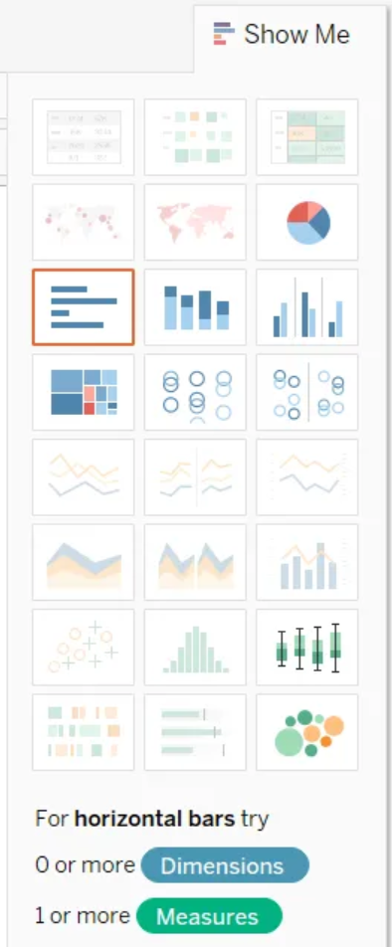
Data Visualization: Marks Card
The Marks Card contains different visualizations, such as: bubble charts, tree maps, box plots, etc.
However, some of them might be too complex to interpret, so try to explore and use them cautiously.

Slide 14
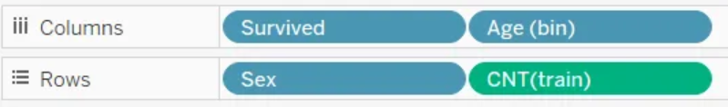
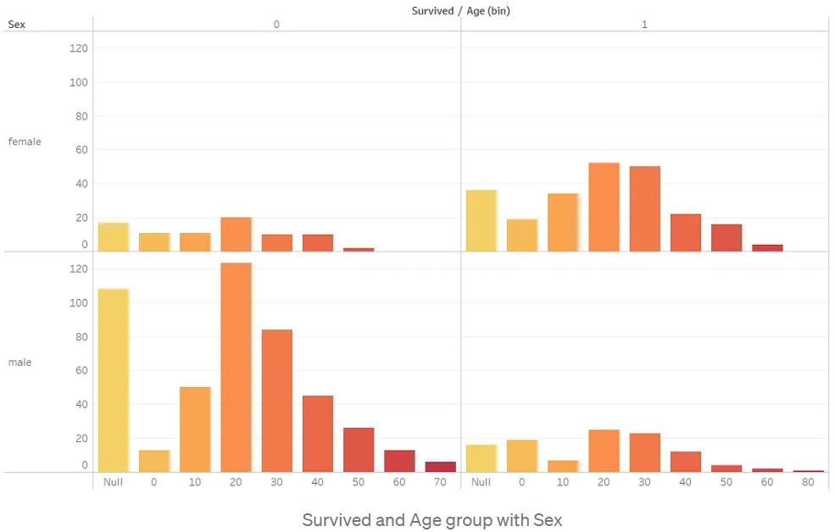
Data Visualization: Multiple Variables
Let’s visualize the relation between ‘Age’, ‘Sex’, and ‘Survived.’ variables

Slide 15
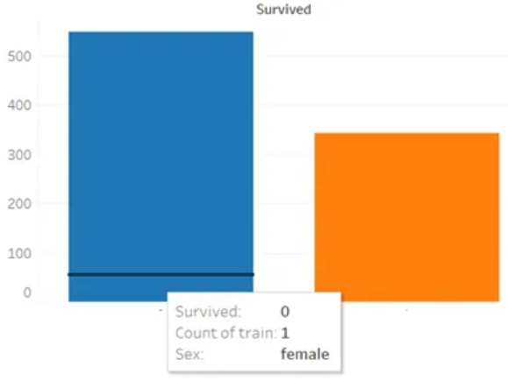
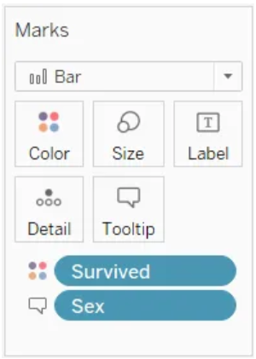
Tooltips and Annotations
Tooltips and annotations can make it easier for people to read your graph.
Tooltips are the details that appear when you hover your pointer over the visualization
Add the column for which you need to add a tooltip to the Marks card

Slide 16
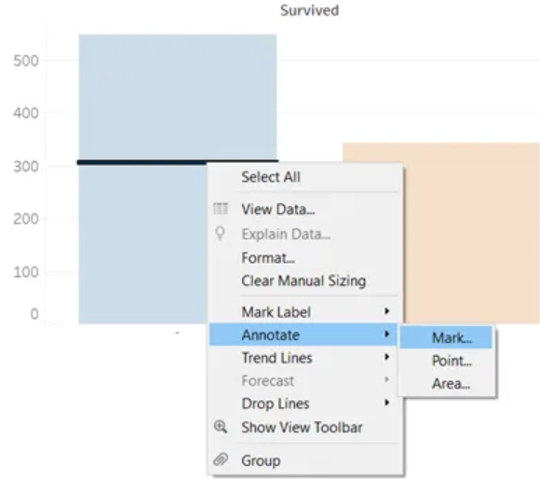
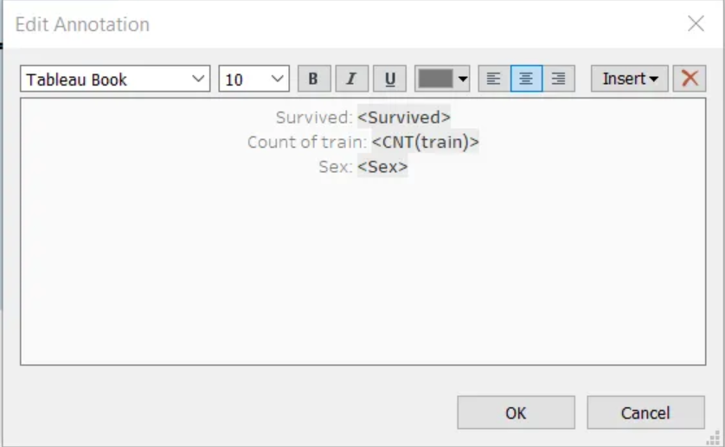
Tooltips and Annotations (cont.)
Annotations are persistent tips, mostly used with maps to draw attention to some areas.
Right click on the chart → annotate → mark
Now remove marks you don’t need, then click OK

Slide 17
Source:
https://medium.datadriveninvestor.com/tableau-tutorial-for-beginners-43483adf719
Additional resources:
https://help.tableau.com/current/guides/get-started-tutorial/en-us/get-started-tutorial-build.htm

